Slide 1
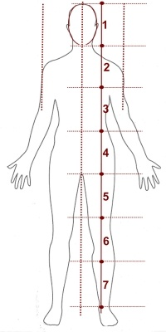
Human Proportions
The basic guide for body proportion is in head lengths.
The figure of an average adult is 7 to 7.5 head lengths:
First head length: head!
Second head length: chest line.
Third head length: waistline, at bellybutton.
Forth head length: groin area.
Fifth head length: a bit above the knee.
Sixth head length: just below knee.
Seventh head length: above ankle.
Seven & 1/2 (or eighth) head length: at bottom of feet.

Slide 10
Other Important measurements that should be noted:
When the arms are at the side, the wrist bone aligns with the groin area.
The elbow aligns with the waistline—around or above the bellybutton.
Shoulder width, side-to-side, is about 2 to 2 1/2 heads wide.

Slide 12
Posemaniacs! ☺
The idea of thirty seconds drawing is to support gesture drawing. You will improve in recognizing aspects of figures in a short amount of time, and be able to draw accurately with minimum lines. Making a large of number of sketches in a small amount of time is good experience, especially for beginners.

Slide 13
Tips
Try to complete your drawing in time.
Think without words while sketching.
Focus on the mass, the flow, and the center of mass, and work on details later.
Try to keep your eyes on the screen instead of your paper.
You will be able to draw faster if you don’t lift your pen off of the paper as you draw.
Draw lines of the back bone and the hip to make good balance.
Ignore details. Its impossible to draw everything. Focus on the pose.

Slide 14
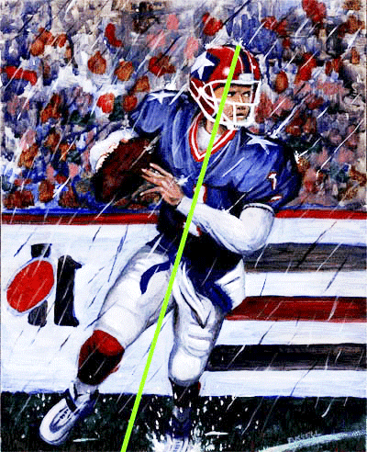
Step One- A line is drawn from the head to the feet.

Slide 15
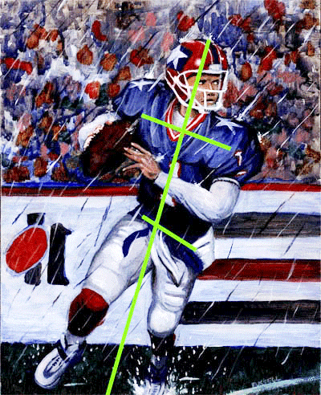
Step Two- Two lines are drawn- One line indicates the shoulder position, the second line indicates the waist position.

Slide 16
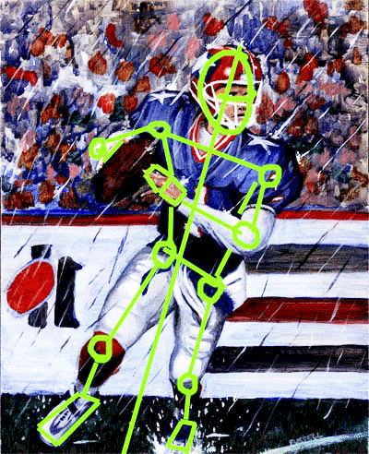
Step Three- A stick figure is drawn- with shapes for the torso, head, hands, and feet.

Slide 17
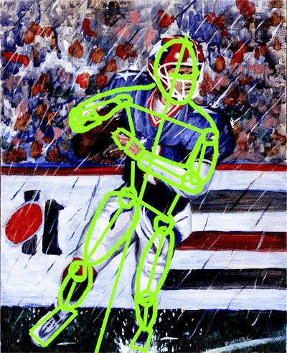
Step Four- "Thicken" the figure to complete the gesture drawing.

Slide 18
Posemaniacs
ALL gesture drawings!
ALL on a 30 second timer
4 Negative Space Drawings
8 Musculature Drawings
Get two pieces of paper and fold into fourths. Open back up and write your name on both pieces of paper. Label one piece of paper “Negative Space Gesture Drawings” and the other “Posemaniacs Gesture Drawings”

Slide 31
http://thevirtualinstructor.com/gesturedrawing.html Gesture Drawing Video (9:00 minutes)

Slide 32
http://www.youtube.com/watch?v=5AMufOx4Hgk&safe=active#t=176 Gesture Drawing Video #2 (4:30 minutes)

Slide 33
http://www.posemaniacs.com/thirtysecond Posemaniacs! ☺

Slide 34
http://www.youtube.com/watch?feature=player_embedded&v=xdNQR7xYW5k
Human Figure Proportion Video

