Slide 1
How to Draw (and SHADE) Hair
Reteach after Portrait Unit Formative #1 – Full Frontal Portrait Drawing off of Reference Photo

Slide 2
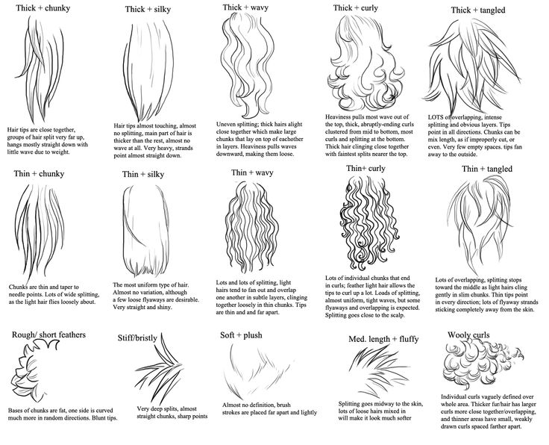
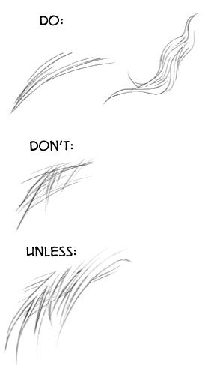

Slide 7
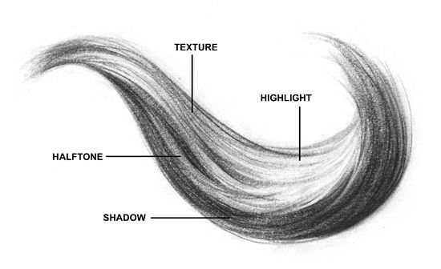

Slide 8
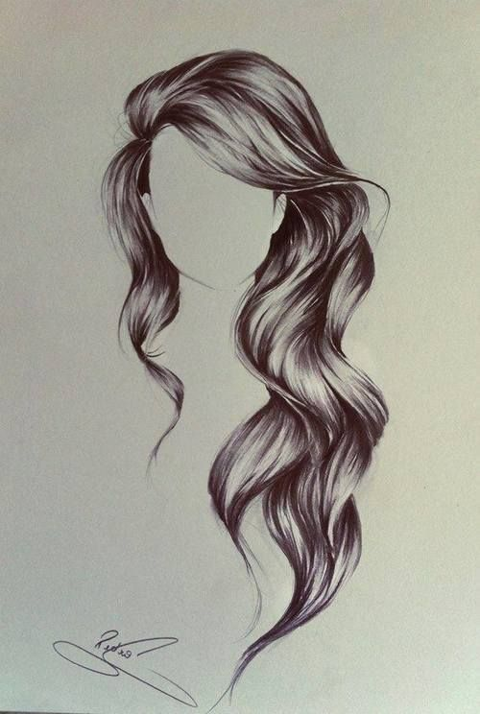
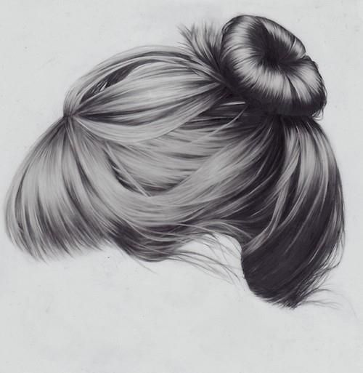

Slide 9
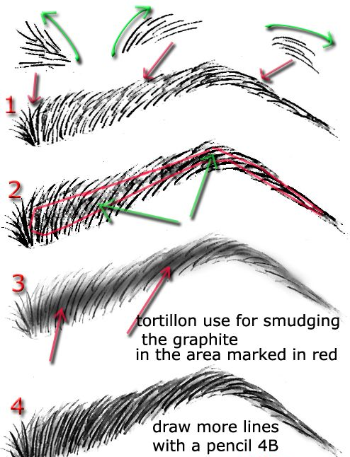
How to
Draw an Eyebrow

