Slide 1
Value Shading Still Life
What is a still life?
How do you compose a still life into a drawing with good composition?
What is the purpose of cropping?
How do you show value in drawing a still life?
How do you make objects look three-dimensional when drawing them on a two-dimensional surface?
How do the elements and principles play an important part in creating “good” artwork?

Slide 2
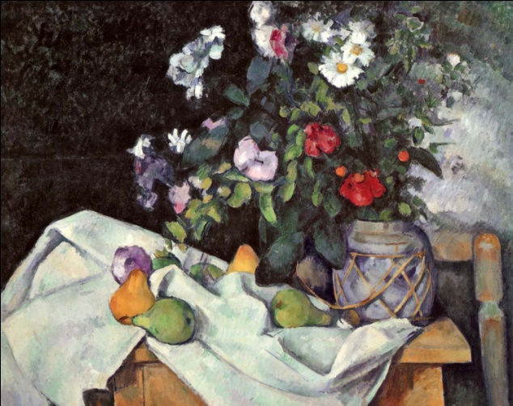
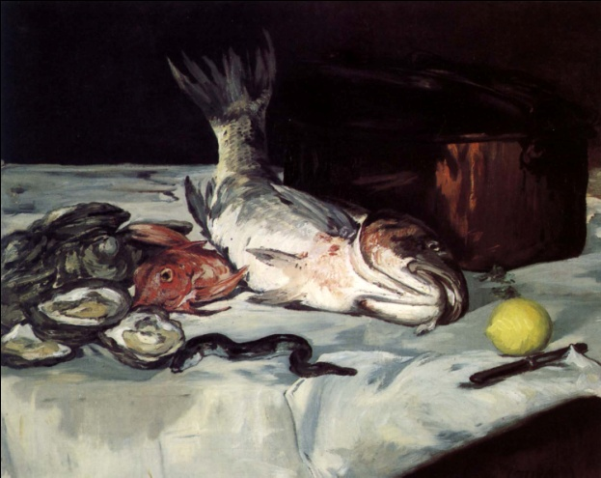
1. Question
Still Life
Next
1
2
3
4
5
6
Still life art is the composition and arrangement of objects that are not alive and cannot move. The practice of creating still life art develops and strengthens your natural level of drawing ability. It improves your observation and rendering of shape, tone, color, pattern and texture in a range of different media.
Examine the pictures on the right to discuss how the artist arranged the visual elements into a final still life composition. Why is the arrangement of the objects important?
Image Source: Public Domain, from Paintings by the Masters
How do artists use compositional and media techniques to communicate intended effects in a still life composition?

Slide 3
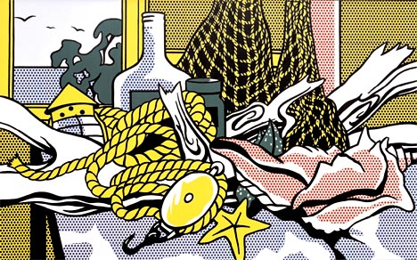
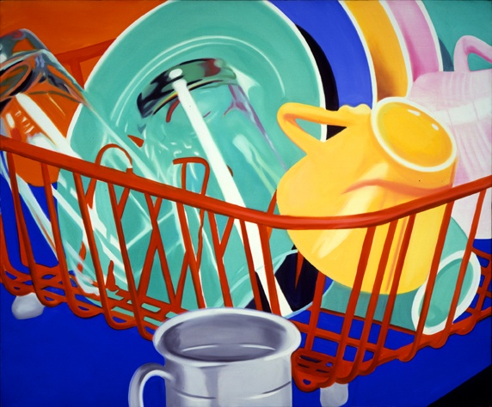
2. Information Sources
Next
1
2
3
4
5
6
You will use these resources to critique and compare two artists’ still life compositions and media techniques:
View these sites and videos to learn more about the still life artists highlighted in the text, A Global Pursuit
Still-life- Amelia Pelaez (Cuba), View this de Haam video
Still-life of Fruit and Flowers - Paul Cézanne (France), View the Cézanne video
Still-life with Parrots- Jan Davidsz de Haam (Netherlands), View this de Haam video
Parrots Live Forever- Audrey Flack (United States), View this Audrey Flack Video
View these sites and videos to learn more about the still life artists highlighted in the text, A Personal Journey
Dishes- 1964, James Rosenquist (United States),
Still-life of Fruit and Flowers-after 1620, Clara Peeters (Flanders), View this Peeters still life video
.
Image Source: WikiPaintings, Cape Cod still life
Image Source: Rosenquist, James. Dishes, 1964. Oil on Canvas, VAGA, New York. A Personal Journey: Explorations in Art. By Marilyn G. Stewart. Massachusetts: Davis Publications, 2009. 55. Print.

Slide 4
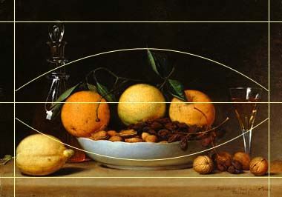
3. Student Activity
Next
1
2
3
4
5
6
Use the sites on Slide 2 to compare two different still life artworks. You may use the attached inquiry organizer or your journal to record ideas and information. Make sure to cite the artists, works, titles, and years as your reflect and compare. Use the following questions as a guide:
How does the artist balance the painting?
Is the composition symmetrical or asymmetrical? How do you know?
Can you see examples of repetition, movement and contrast?
What medium is used for the final still life artwork?
What moods and ideas do you think the painting conveys? Explain your answer using specific examples from the artwork.
You will use what you have learned about still life composition and shading techniques to create your own thumbnail sketches and graphite drawing.
Symmetrical Composition
Image Source: Raphaelle Peale, A Dessert (Still Life with Lemons and Oranges), 1814, oil on panel, National Gallery of Art, Washington, Gift (Partial and Promised) of Jo Ann and Julian Ganz Jr. in memory of Franklin D. Murphy 1999.44.1, Net Trekker Subscription

Slide 5
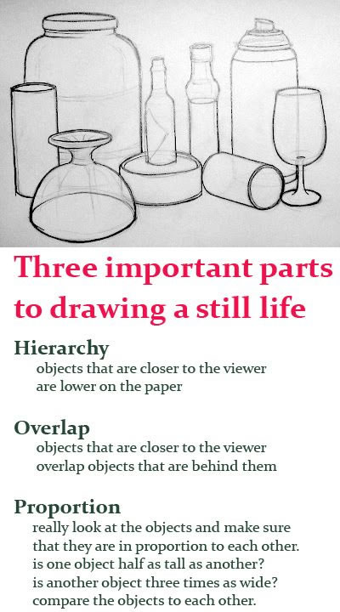
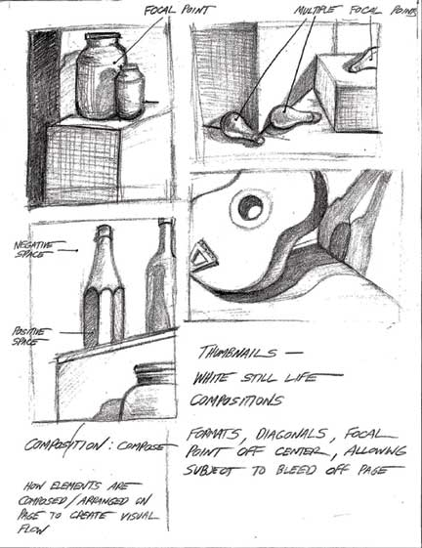

Slide 6
4. Assessment Activity Value Shading Still Life Directions:
Find three different viewpoints that you like.
Use your cell phone to take cropped pictures OR
Use a viewfinder to find a cropped view.
Draw three thumbnail sketches showing very different views of the still life.
Conference with Mrs. Swader over best composition.
Choose between using white or black paper for this assignment (white paper – shadows, black paper – highlights)
Sketch LIGHTLY your still life with #2 pencil.
Shade in your values!
This should be your best art assignment yet! Take your time, draw what you see and not what you “think” you see! Ask for help if stuck/frustrated!

Slide 7
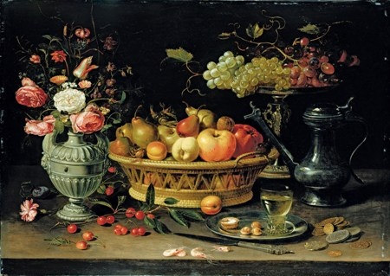
4. Assessment Activity
Next
1
2
3
4
5
6
Reflect on the artists and artwork you explored in the Student Activity. Think about what objects you would like to use for the subject of your own still life work. What are your interests? What objects do you use on a daily basis? What objects reflect an issue or topic that’s important to you?
Working from observation, use the still life value shading rubric to take you through the process of completing still life thumbnail sketches and final graphite drawing that utilizes accurate placement, proportion of items, and values to depict form. The finished graphite drawing should appear realistic including the use of shading, cast shadows, and highlights.
As you plan your still life drawing and prepare to sketch, think about:
How to break down a still life drawing into shapes.
How a sketch will have to achieve a level of proportion and composition in order to prepare you to create a still life drawing.
Why artists generate several drawings or studies of the same or similar objects.
Image Source: Peeters, Clara. Still Life of Fruit and Flowers, after 1620. Oil on Copper, Asholean Museum, Oxford. A Personal Journey: Explorations in Art. By Marilyn G. Stewart. Massachusetts: Davis Publications, 2009. 156. Print.

Slide 8
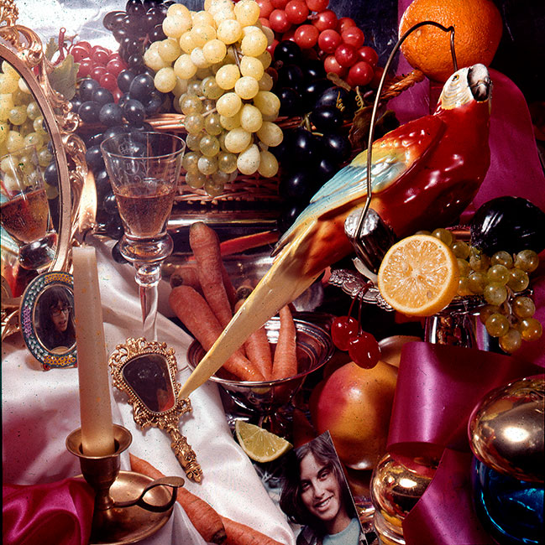
5. Enrichment Activities
Next
1
2
3
4
5
6
Explore Still Life
Take a Still Life Tour from the National Gallery of Art
View the site that scoops about what is going on in the world of Still Life today
View this Still Life Glogster to explore an example of how to organize your art and reflections
Visit the The Metropolitan Museum of Art still life site and explore the collection by artist and era
Browse the still life artists featured at the MoMA
Visit NGA Kids Still Life to create your own still life composition
Image Source: Flack, Audrey. Parrots Live Forever, 1978. Oil over acrylic on canvas, Louis K. Meisel Gallery, New York. A Global Pursuit: Explorations in Art. By Marilyn G. Stewart. Massachusetts: Davis Publications, 2009. 133. Print.

